Slide 1
Representing Dynamic Scenes using Physics-Integrated Gaussian Splatting
Taekbeom Lee Yeonkyu Lee Hongmo Jung

Slide 2
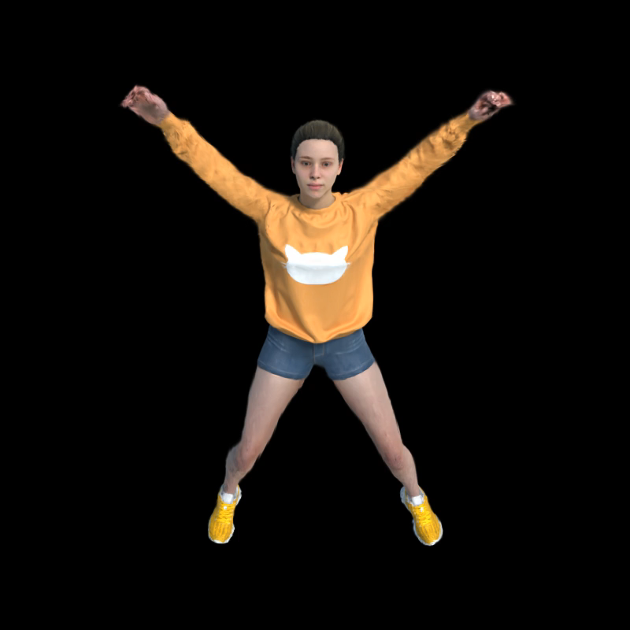
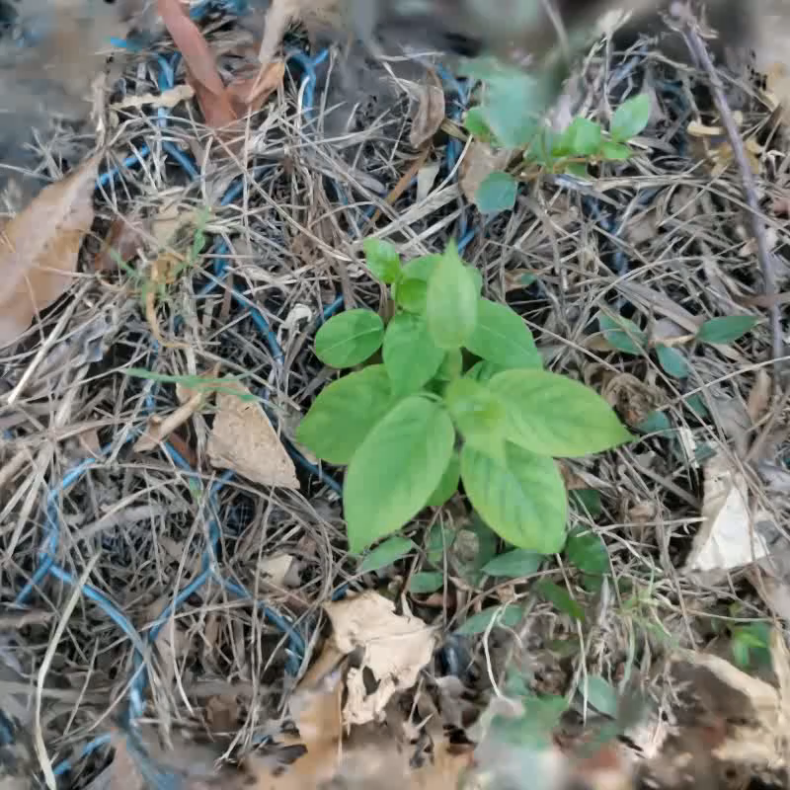
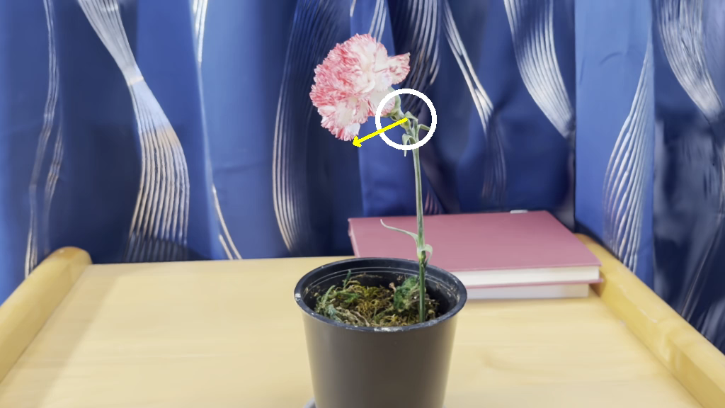
1. Introduction
(1) Dynamic Scene Modeling using 3D-GS
Deformable 3D GS
SC-GS
PhysDreamer

Slide 3
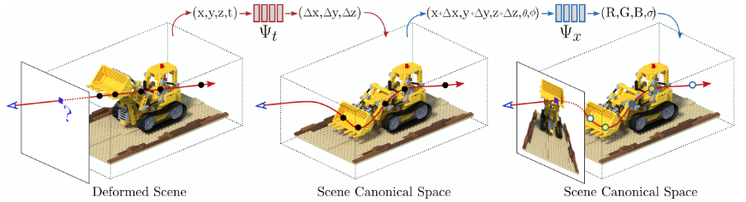
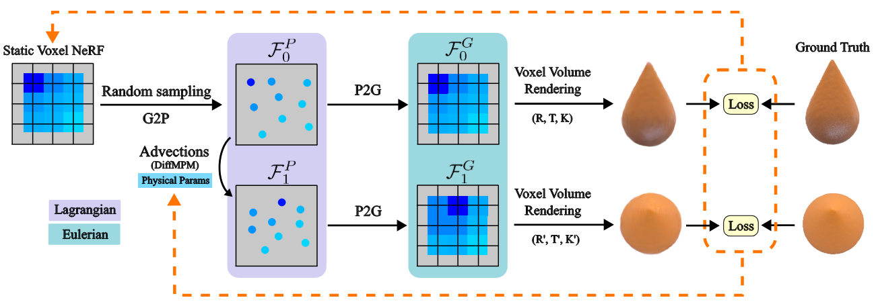
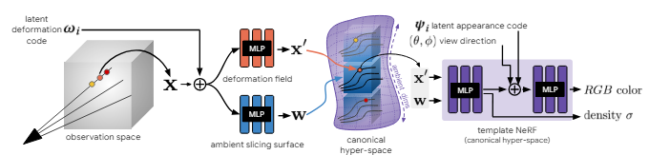
1. Introduction
(2) Dynamic Scene Modeling – NeRF
 | Overview | Modeling Method | Motion Editing
D-NeRF |  | Canonical +Deformation | X
HyperNeRF |  | Canonical Hyper Space | X
PAC-NeRF |  | Physics Based | X

Slide 4
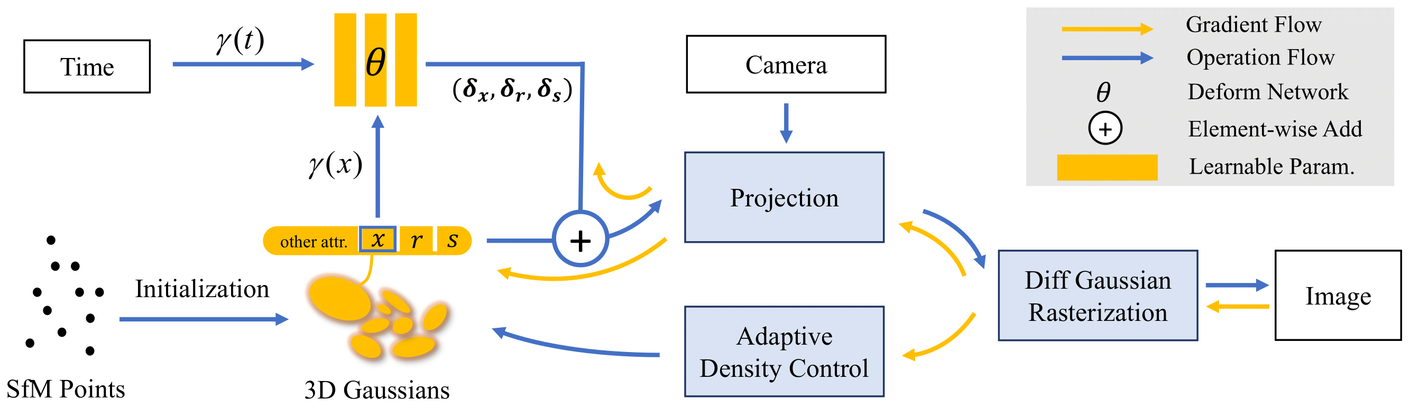
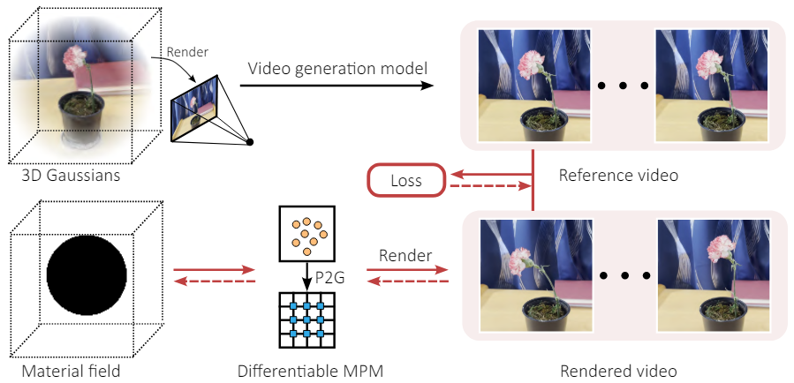
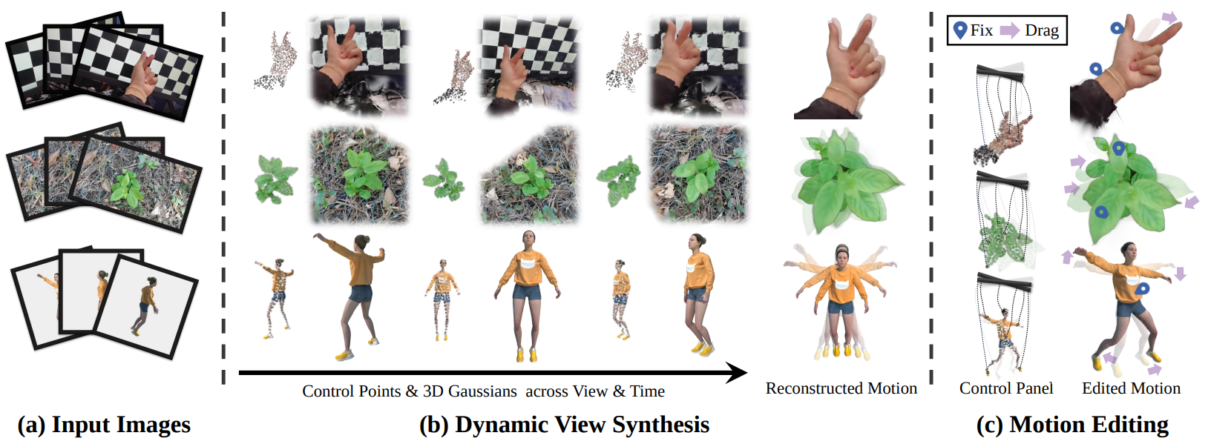
1. Introduction
(2) Dynamic Scene Modeling – 3D-GS
 | Overview | Modeling Method | Motion Editing
Deformable 3D Gaussians |  | Canonical +Deformation | X
SC-GS |  | Sparse Control Point | O
PhysDreamer |  | Physics Based | O

Slide 5
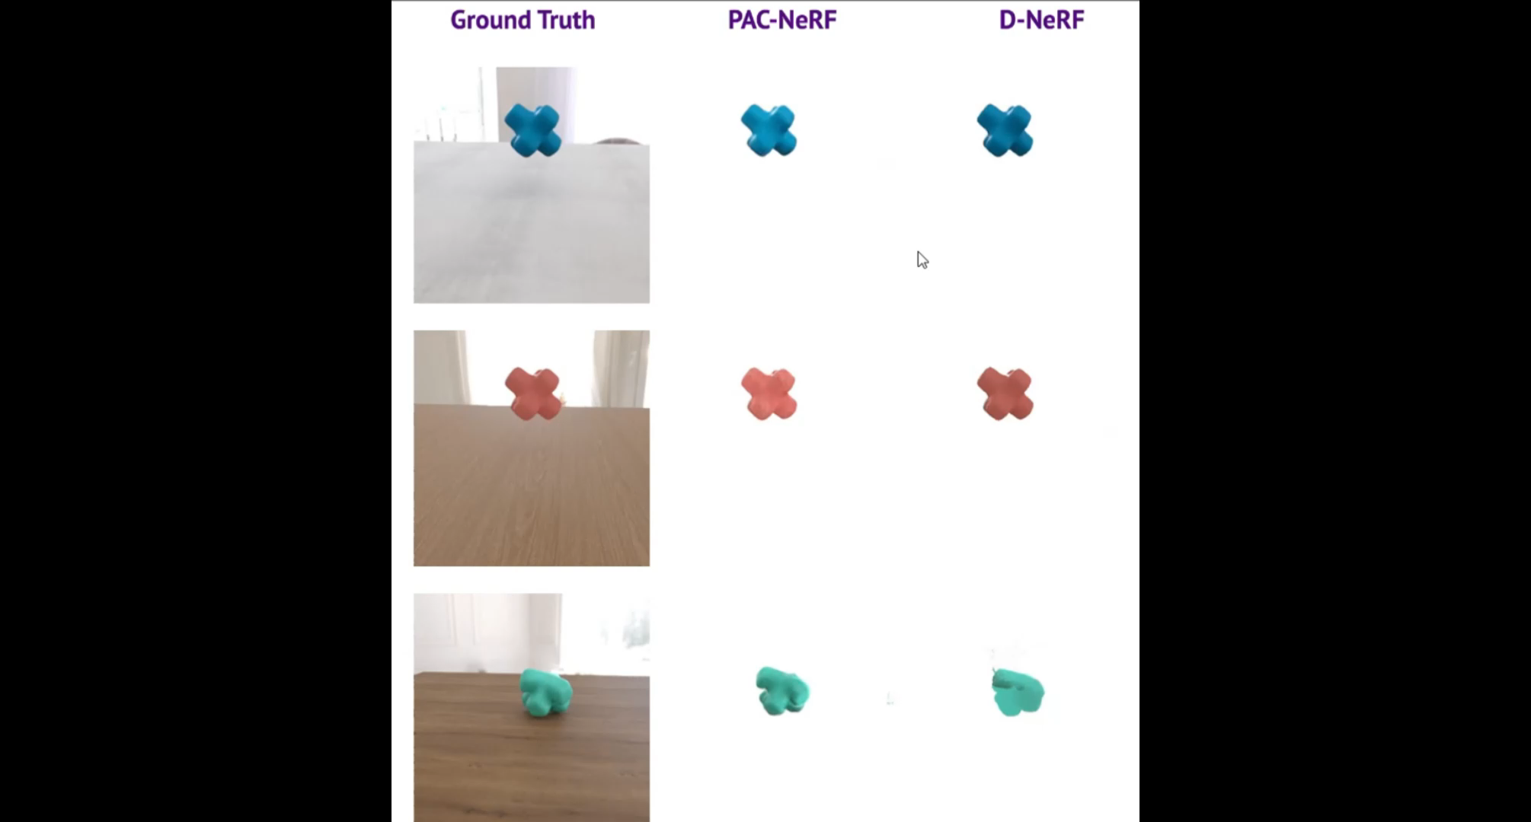
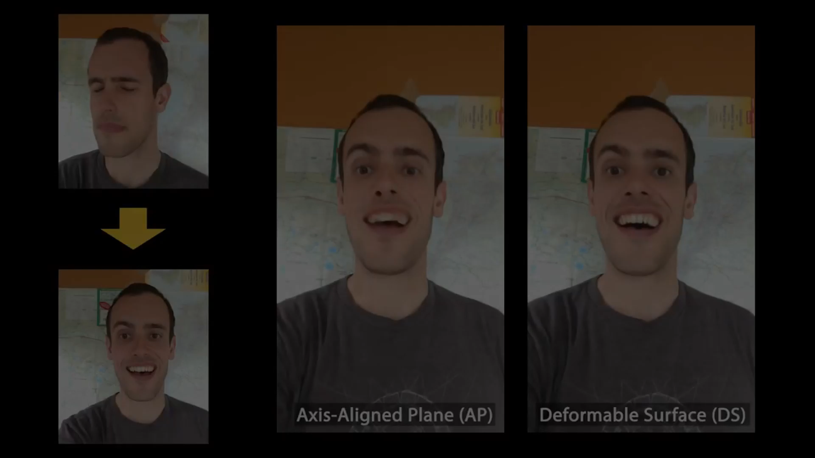
1. Introduction
(3) Motivation : Limitation of Canonical + Deformation method
Notes:
이 slide 시작 시 1분 정도 소요됬어야!

Slide 6
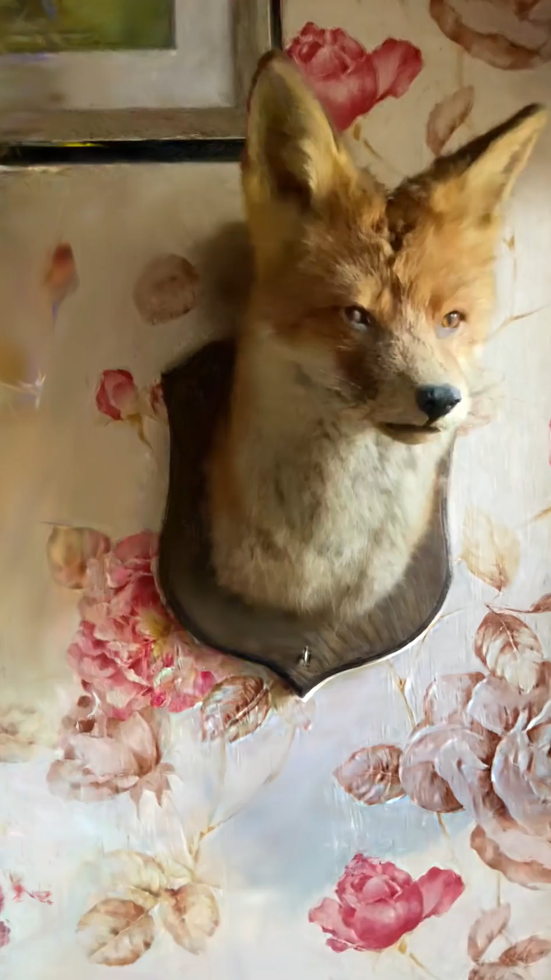
1. Introduction
(4) Physics-Based Method
1. handle topology changes and frictional contacts; allowing the simulation of a wide range of materials.
2. While methods like hyperNeRF can model highly-deformable motion without relying on physics, physics-based approaches have the added advantage of generating physically plausible novel motion.

Slide 7
1. Introduction
(5) Difference from other Physics-Based Study
VS PhysDreamer
W/O pretrained static 3D-GS Our study differs from PhysDreamer because it does not require 3D static Gaussian data.
Instead, it simultaneously utilizes dynamic video to learn 3d gaussians and material properties.
VS PAC-NeRF
Limitation of NeRF Scene Representation NeRF-based scene representation methods take longer to render compared to 3D-GS.
Additionally, in terms of representing 3D scenes, NeRF uses an implicit representation method,
making it less suitable for applying physics compared to the explicit representation method of 3D-GS.

Slide 8
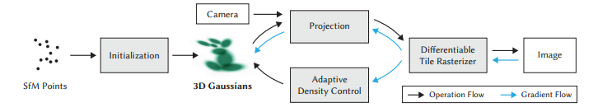
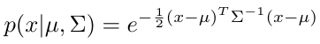
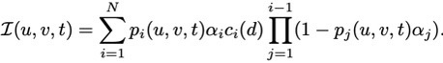
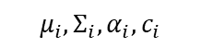
2.1 Preliminaries
(1) 3D Gaussian Splatting
$$μ_{i}, Σ_{i},α_{i},c_{i}$$

Slide 9
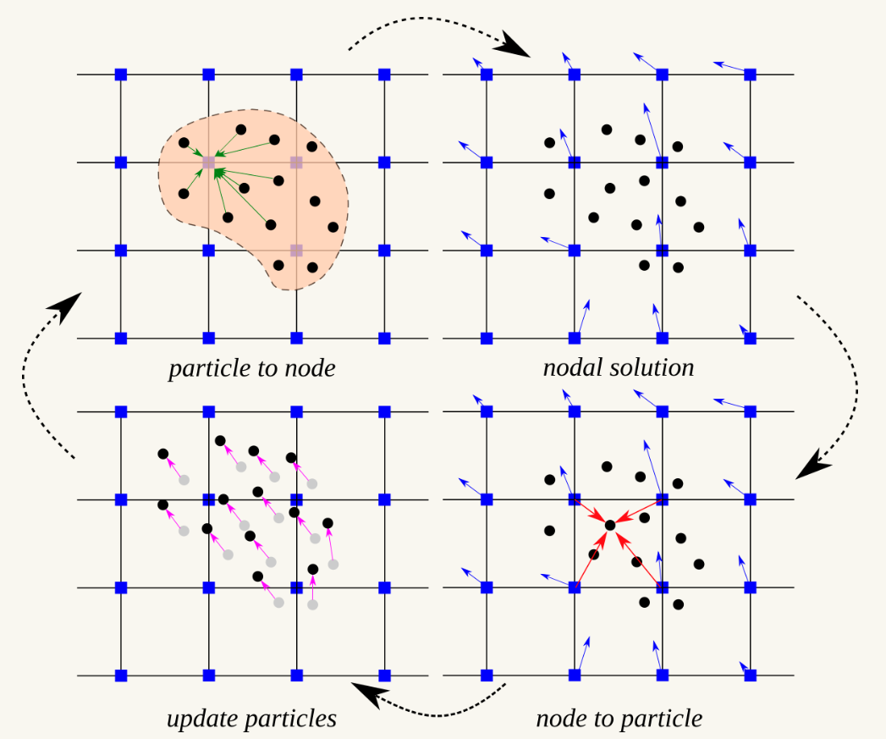
2.1 Preliminaries
(2) Material Point Method
- The material to be simulated is represented by a collection of material points
Particle-to-grid (P2G): transfers material point to computation grid
Next state is calculated
Grid-to-particle (G2P): transfers computed properties
Update material points

Slide 10
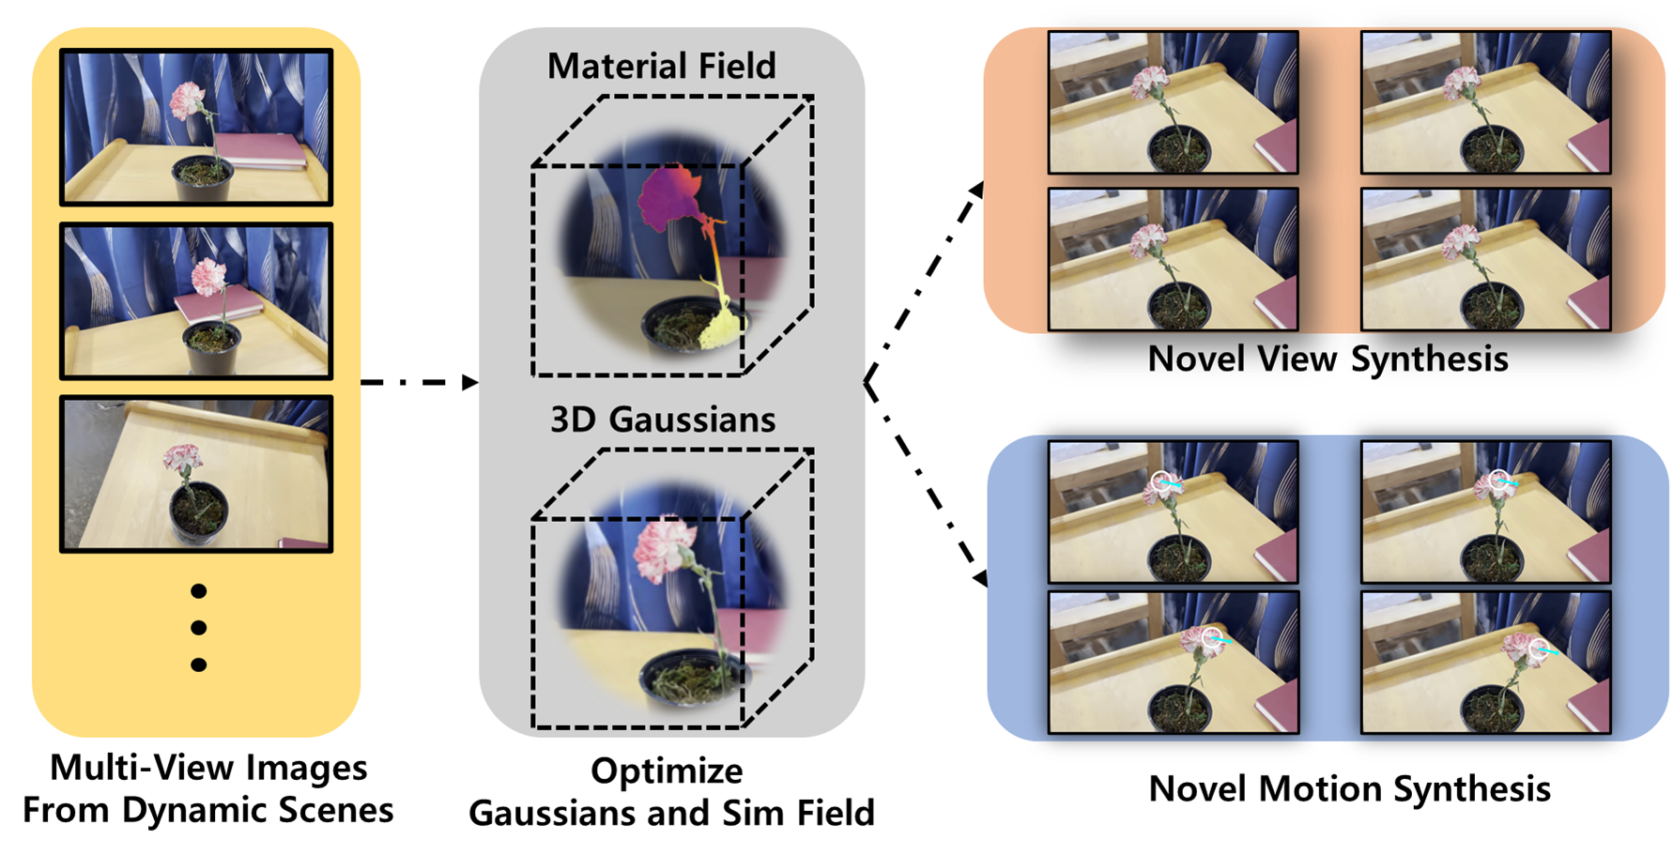
2.2 Problem Setting & Overview

Slide 11
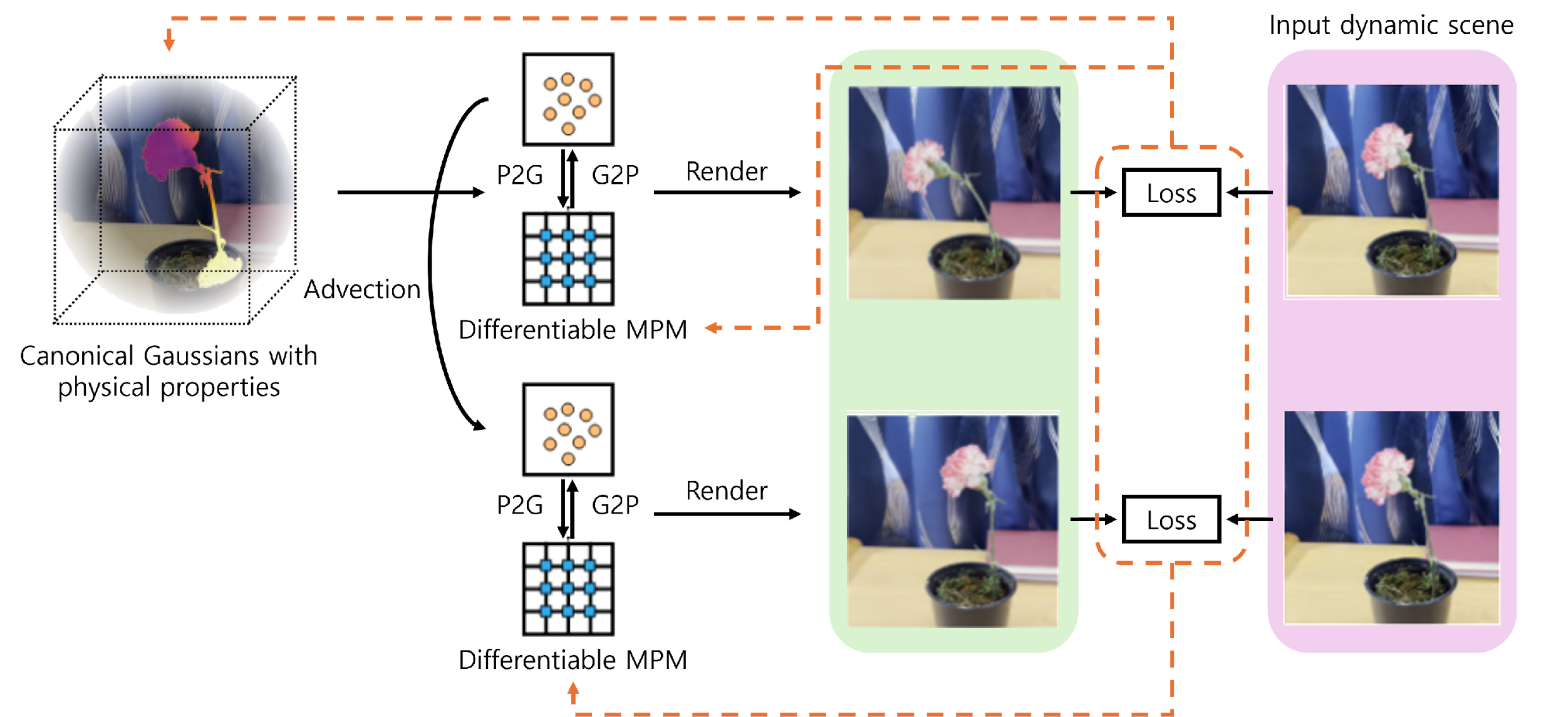
2.3 Pipeline of Our Method
Canonical Gaussians Optimized
Input initial Gaussians generated with
Structure-from-Motion
Jointly!!
Multi-view images from highly deformable & dynamic scene (=Train video from generative model)
Initial Velocity Field & Sim(=Material) Field Optimized

Slide 12
2.4 Training Process
(1) Stage 0 : Warm-Up -Initialize the model by focusing on the initial Gaussian parameters: Freeze the velocity (vel) and simulation (sim) fields to optimize based on initial Gaussians only. -> Adjust the Gaussian parameters to fit the initial few frames of data (e.g., first 3 frames). -WHY? -> Our model starts with gaussians just initialized with SfM. -> Allows the model to establish a good starting point for Gaussian parameters. -> Prevents drastic changes in the early stages that could destabilize training.

Slide 13
2.4 Training Process
(2) Stage 1 : Joint Training of Initial Velocity and Gaussians - Freeze Sim Field(Randomly initialize the Young’s modulus for each Gaussian particle) and jointly optimize the Initial Velocity Field and the Canonical Gaussians -> Use a short time window(e.g., first 3 frames) to optimize
(3) Stage 2 : Optimize Sim Field - Freeze the Initial Velocity and Gaussians and optimize Sim Field -> Let the gradient only flow to the previous frame to prevent gradient explosion/vanishing
-WHY? -> For better Stability and faster convergence

Slide 14




3.1 Tasks, Datasets, Baselines
(1) Novel view synthesis
- Simulate the dynamic scene in the training video again, render video from novel view
- Dataset: PAC-NeRF dataset (11 videos w/ 14 time-synched frames) - Baseline: PAC-NeRF (scene representation: static voxel NeRF)

Slide 15
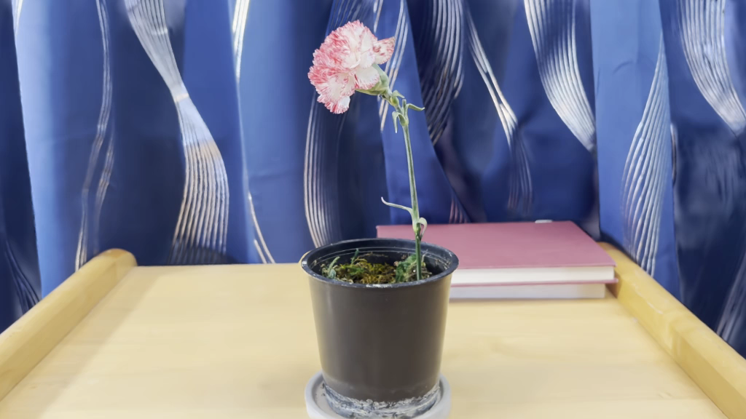
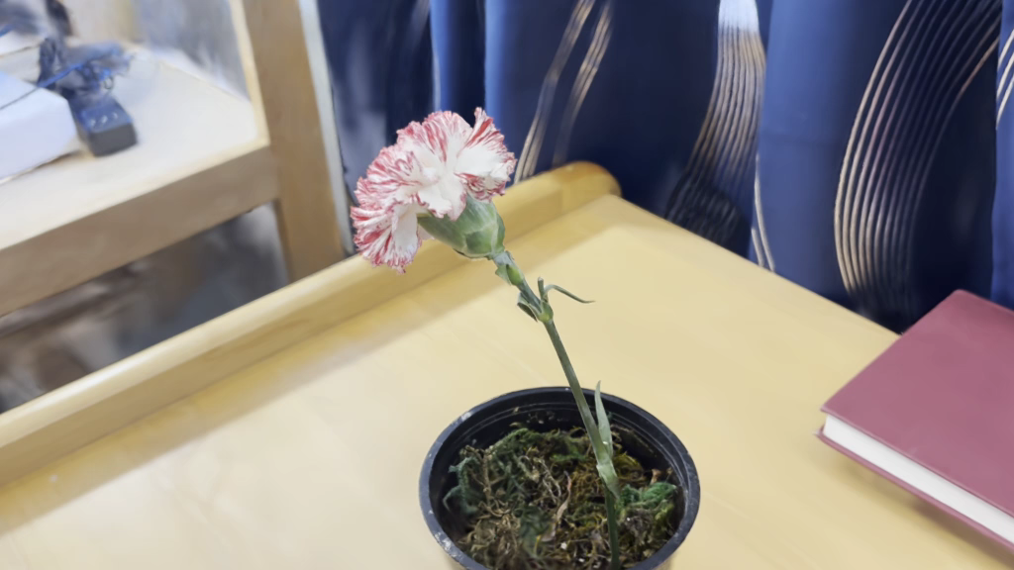
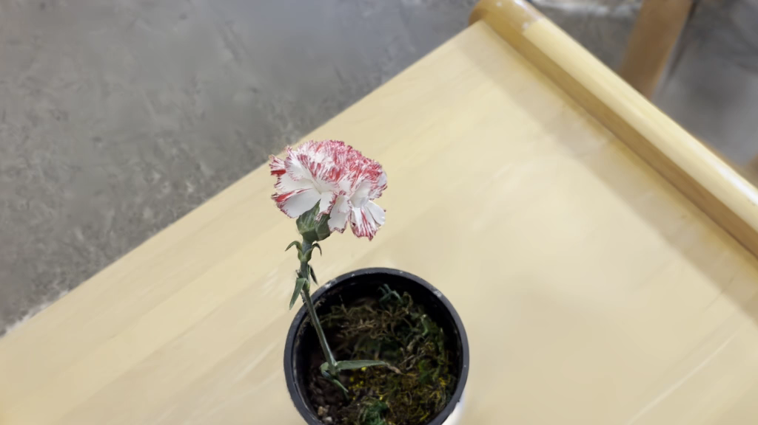
3.1 Tasks, Datasets, Baselines
(2) Novel motion synthesis
- Simulate novel motion w/ learned material property and user-defined force
- Dataset: PhysDreamer dataset (videos generated by diffusion, multiple viewpoints)

Slide 16
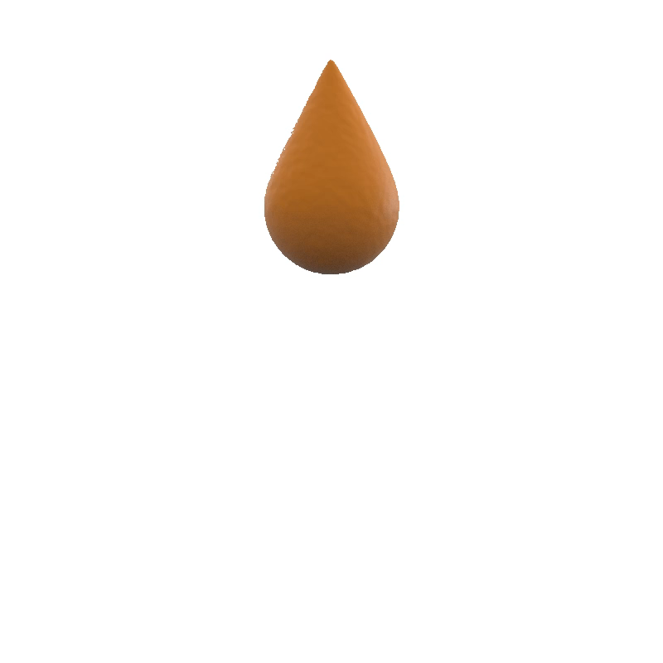
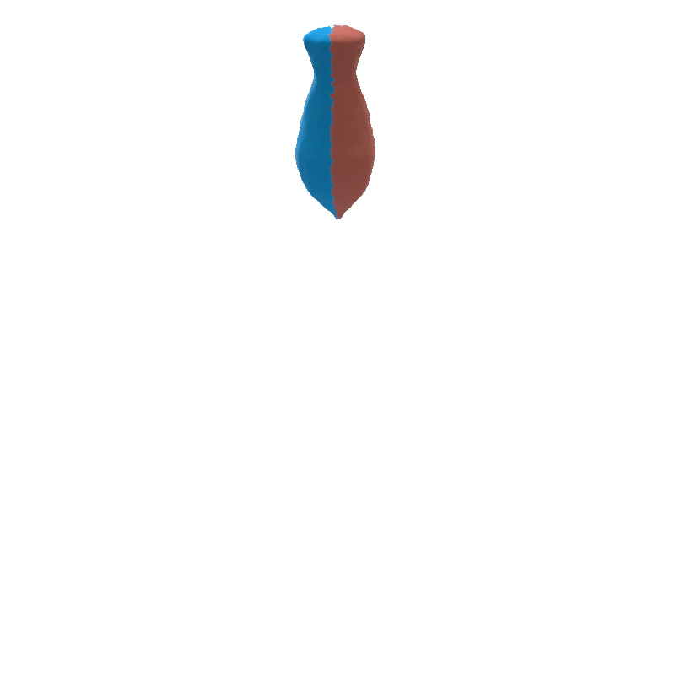

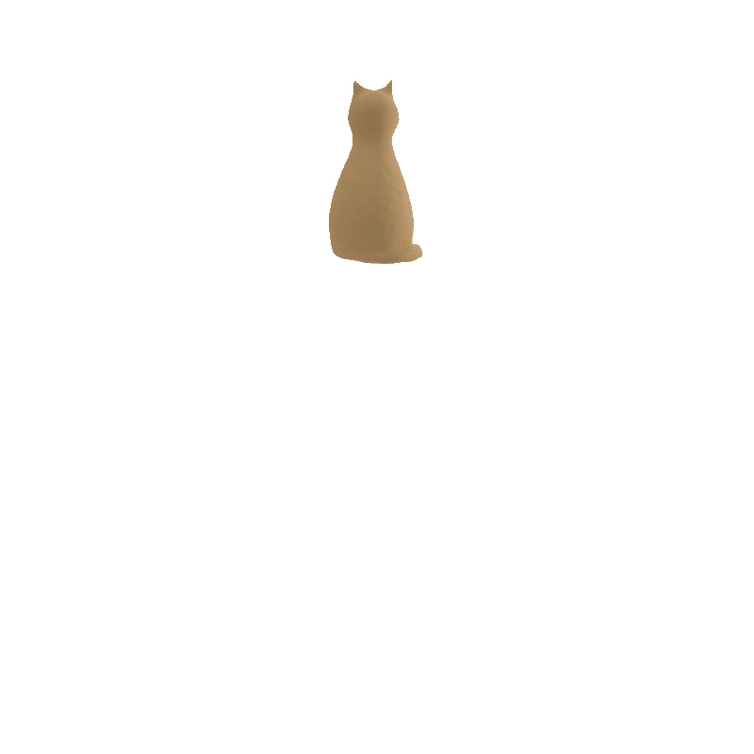
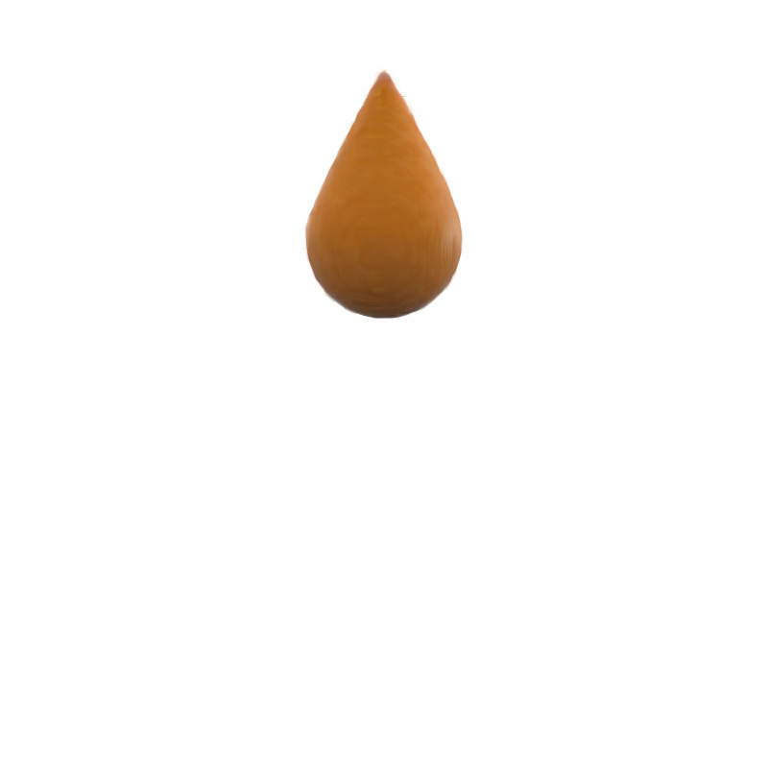


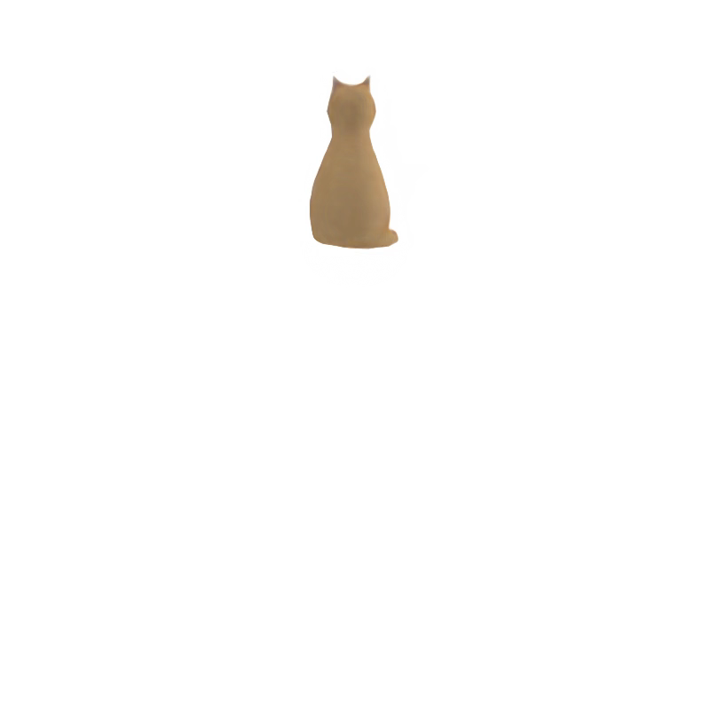
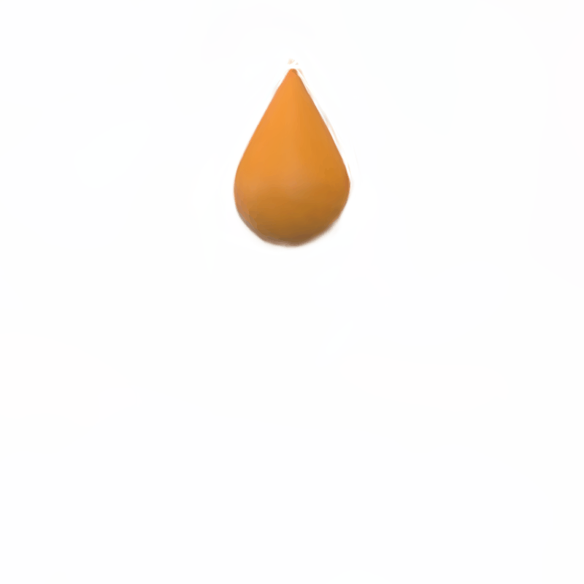
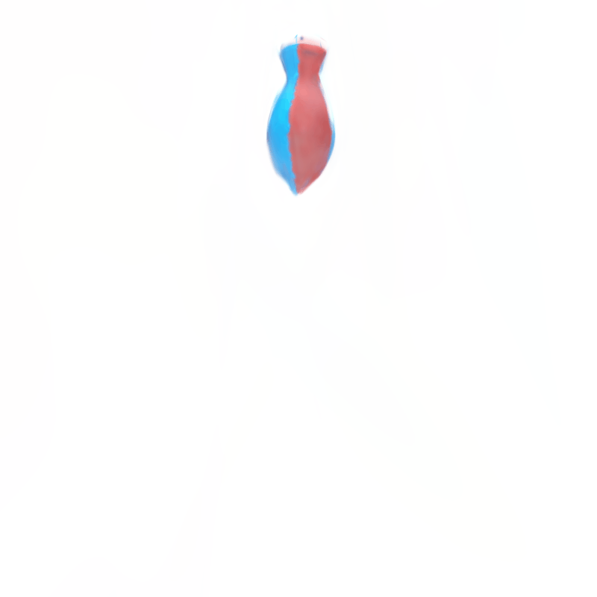

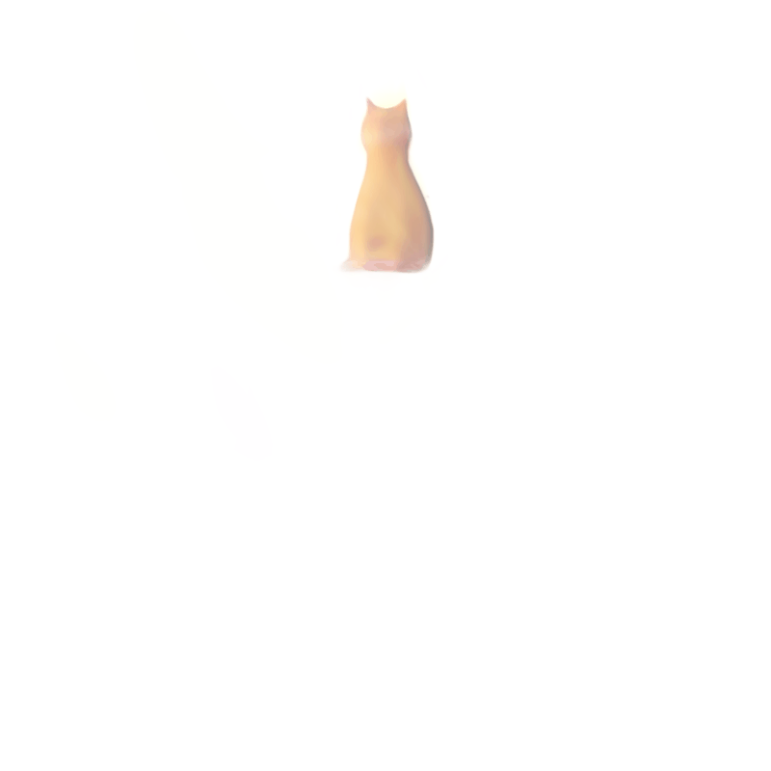
3.3 Result: Novel view synthesis
GT
PAC-NeRF
Ours

Slide 17
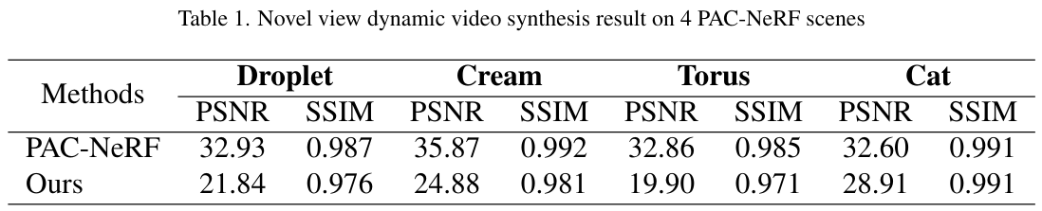
3.3 Result: Novel view synthesis

Slide 18

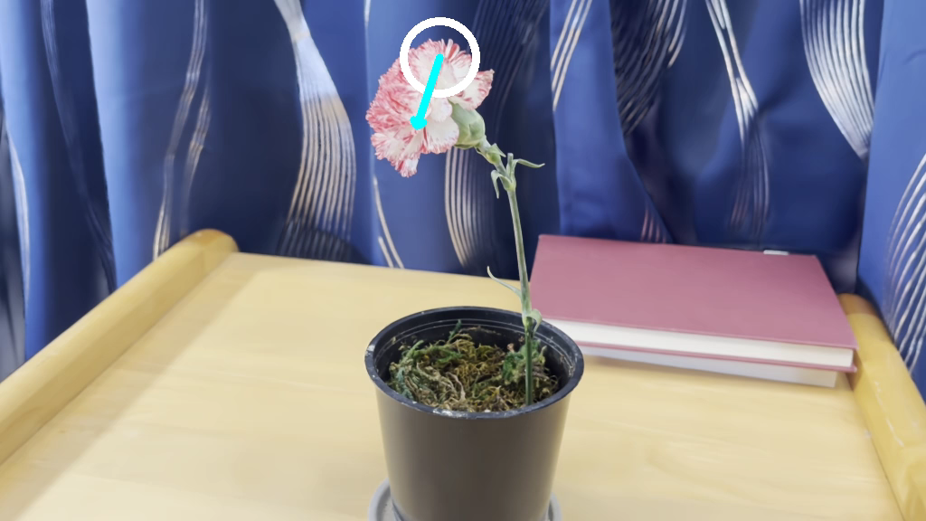
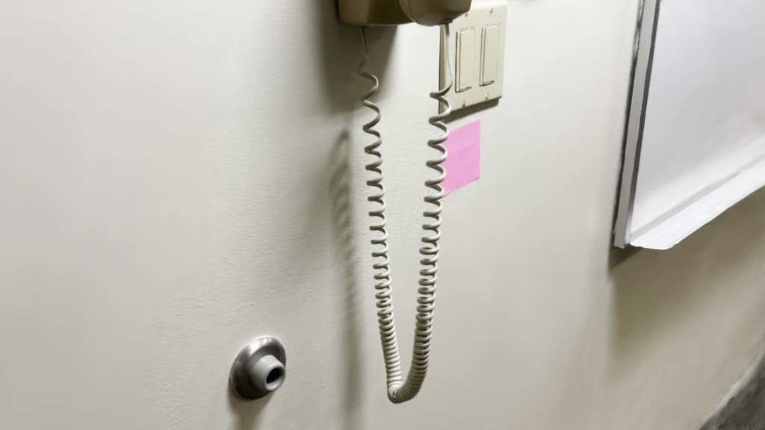
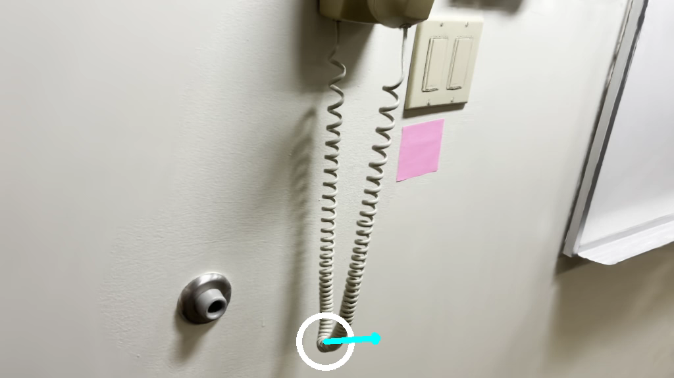
3.2 Result: Novel motion synthesis
Input dynamic scene
Novel dynamic scene
w/ novel motion

Slide 19
Thank you!

